Slide 1
Radiation Detection UAV
Advisor: Dr. Christopher Peters
Co-Advisor: Dr. Ani Hsieh
Arturs Bergs
Thomas Boyd
Kevin Hall
Marko Jacovic

Slide 2
The Product
Micro Unmanned Aerial Vehicle
For closed environments
Senses and maps radiation levels

Slide 3
Current Status
UAV Construction complete
Wireless serial communication from Geiger counter, accelerometer and magnetometer complete
3D mapping of position pertaining to Geiger counter readings and Radiation dial complete
GUI re-created in Matlab

Slide 4
Timeline
Winter Term Goals
Spring Term Goals
    Remote control of UAV
    Wireless communication
    Live video feed
    Display of real time data
    Live mapping of data

Slide 5
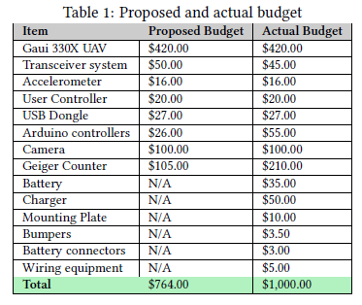
Proposed Vs. Actual Budget

Slide 6
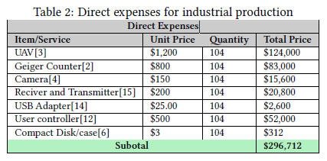
Industrial Budget
Direct Expenses
Notes:
Quantity of 104 was chosen due to number of nuclear reactors in country. Each part selected performs better for higher price as trade off. Have reference for each product, will update later.

Slide 7
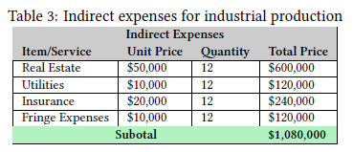
Industrial Budget
Indirect Expenses
Notes:
Real Estate required was estimated to be 250 sq ft per employee. 35 people, resulted in 7000 sq ft required. RiverView Place Office Space in Philadelphia has rate off $11/sq ft/year. Utilities were estimated to be $2.50 per sq foot per year. Fringe Befits based on 30 percent of all employee salaries per month.

Slide 8
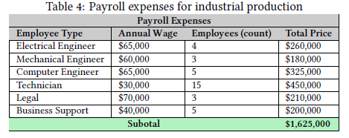
Industrial Budget
Payroll Expenses
Notes:
All annual wages were determined from the U.S. Bureau of Labor Statistics, for Average Philadelphia area positions of the listed types. Particular differences to note: Computer Hardware Engineer, Electro-Mechanical Technician, Legal Support Workers, Sales Representatives

Slide 9
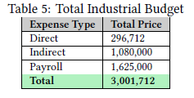
Industrial Budget
Total Expenses

Slide 10
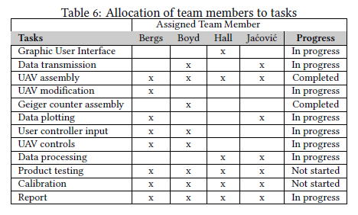
Schedule

Slide 11
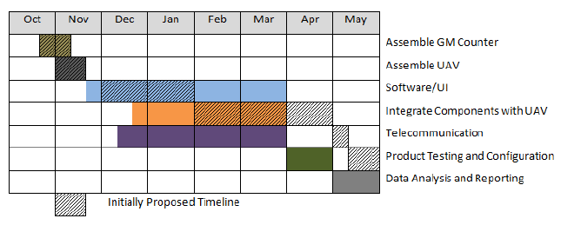
Timeline

